Slide 1
Communication: Meaning and the Elements of a Communication Process WEEK 1
By: Ms. PATRICIA E. MANKATAH

Slide 2
LEARNING OBJECTIVES
By the end of the lecture, the student should be able to;
Explain the meaning of Communication.
Outline five (5) importance of Communication.
Mention and explain the elements of the Communication Process.

Slide 3
Introduction to Communication
Communication is the process of exchanging information, ideas, thoughts, or feelings between individuals or groups.
It is essential for building relationships, sharing knowledge, and achieving understanding.
Can be verbal, non-verbal, written, or visual.

Slide 4
Meaning of Communication
Derived from the Latin word communicare, meaning "to share”.
Involves a sender transmitting a message to a receiver through a chosen channel.
Effective communication ensures clarity, understanding, and feedback.

Slide 5
Importance of Communication
Facilitates coordination and
teamwork.
Helps in decision-making.
Builds trust and relationships.
Essential for leadership and
management..
(Many more as discovered during lecture)

Slide 6
Elements of the Communication Process
Sender – The originator of the message.
Message – The information, idea, or thought
being communicated.
Encoding – The process of converting ideas
into words, symbols, or gestures.
Channel – The medium used (spoken word, .
email, text, etc.).

Slide 7
Elements of the Communication Process (cont’d)
Receiver – The person or group who interprets the message.
Decoding – The process of interpreting and understanding the message.
Feedback – The receiver’s response to the sender.
Noise – Any interference that distorts or disrupts communication.

Slide 8
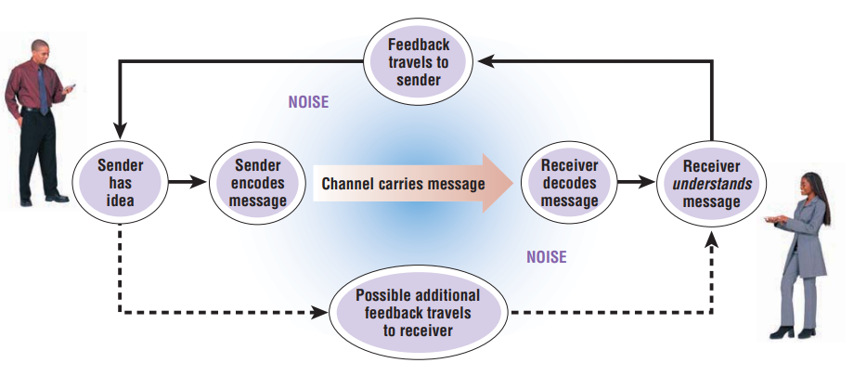
Visual Representation Process of Communication

Slide 9
Example of Communication in Action
Workplace scenario:
Manager giving instructions to a team.
Sender: Manager
Message: Task instructions
Channel: Email or meeting
Receiver: Team members
Feedback: Questions or task completion
Noise: Misinterpretation, technical issues

Slide 10
CONCLUSION
Communication is the foundation
of human interaction.
Understanding its elements helps
improve clarity and effectiveness.
Effective communication reduces
misunderstandings and strengthens
collaboration.

